Slide 1
Analyzing consumer complaints
By: dalya, zoya , & Maqbool

Slide 2
Resources
Data.GOV
Consumer_complaints.CSV
305,706,093 bytes (305.7 MB on disk)
Notes:
We got our data from DATA.GOV, we used a CSV file and for analyzing the data we used python script

Slide 3
What is tm?
Text mining is also known as intelligent text analysis, text data mining, or knowledge-discovery in text
Refers to the process of extracting interesting and non-trivial information and knowledge from unstructured text
deriving high-quality information
Notes:
The end result is high quality information

Slide 4
Why use tm?
Comsumer complaints usually in paragraph form
Tm techniques help organize data
retrives valuable information from textual data
Allows data to be easily analyzed
Notes:
When a customer goes to the company website or other site to submit their complaint, their issue is usually formatted in paragraph form. it also contains more than the necessary information such as stop words or punctuations. Text mining takes this data which considered unstructured and spits out only the useful information.

Slide 5
Process
Text Preprocessing
Text analysis
Array of words, with stop words removed
Notes:
First we read the complaints from the customer and remove the stop words, then we analyze the complaints according to your requirements such as how many complaints filed were resolved in time, how were the complaints closed, what the complaint was about, and much more.

Slide 6
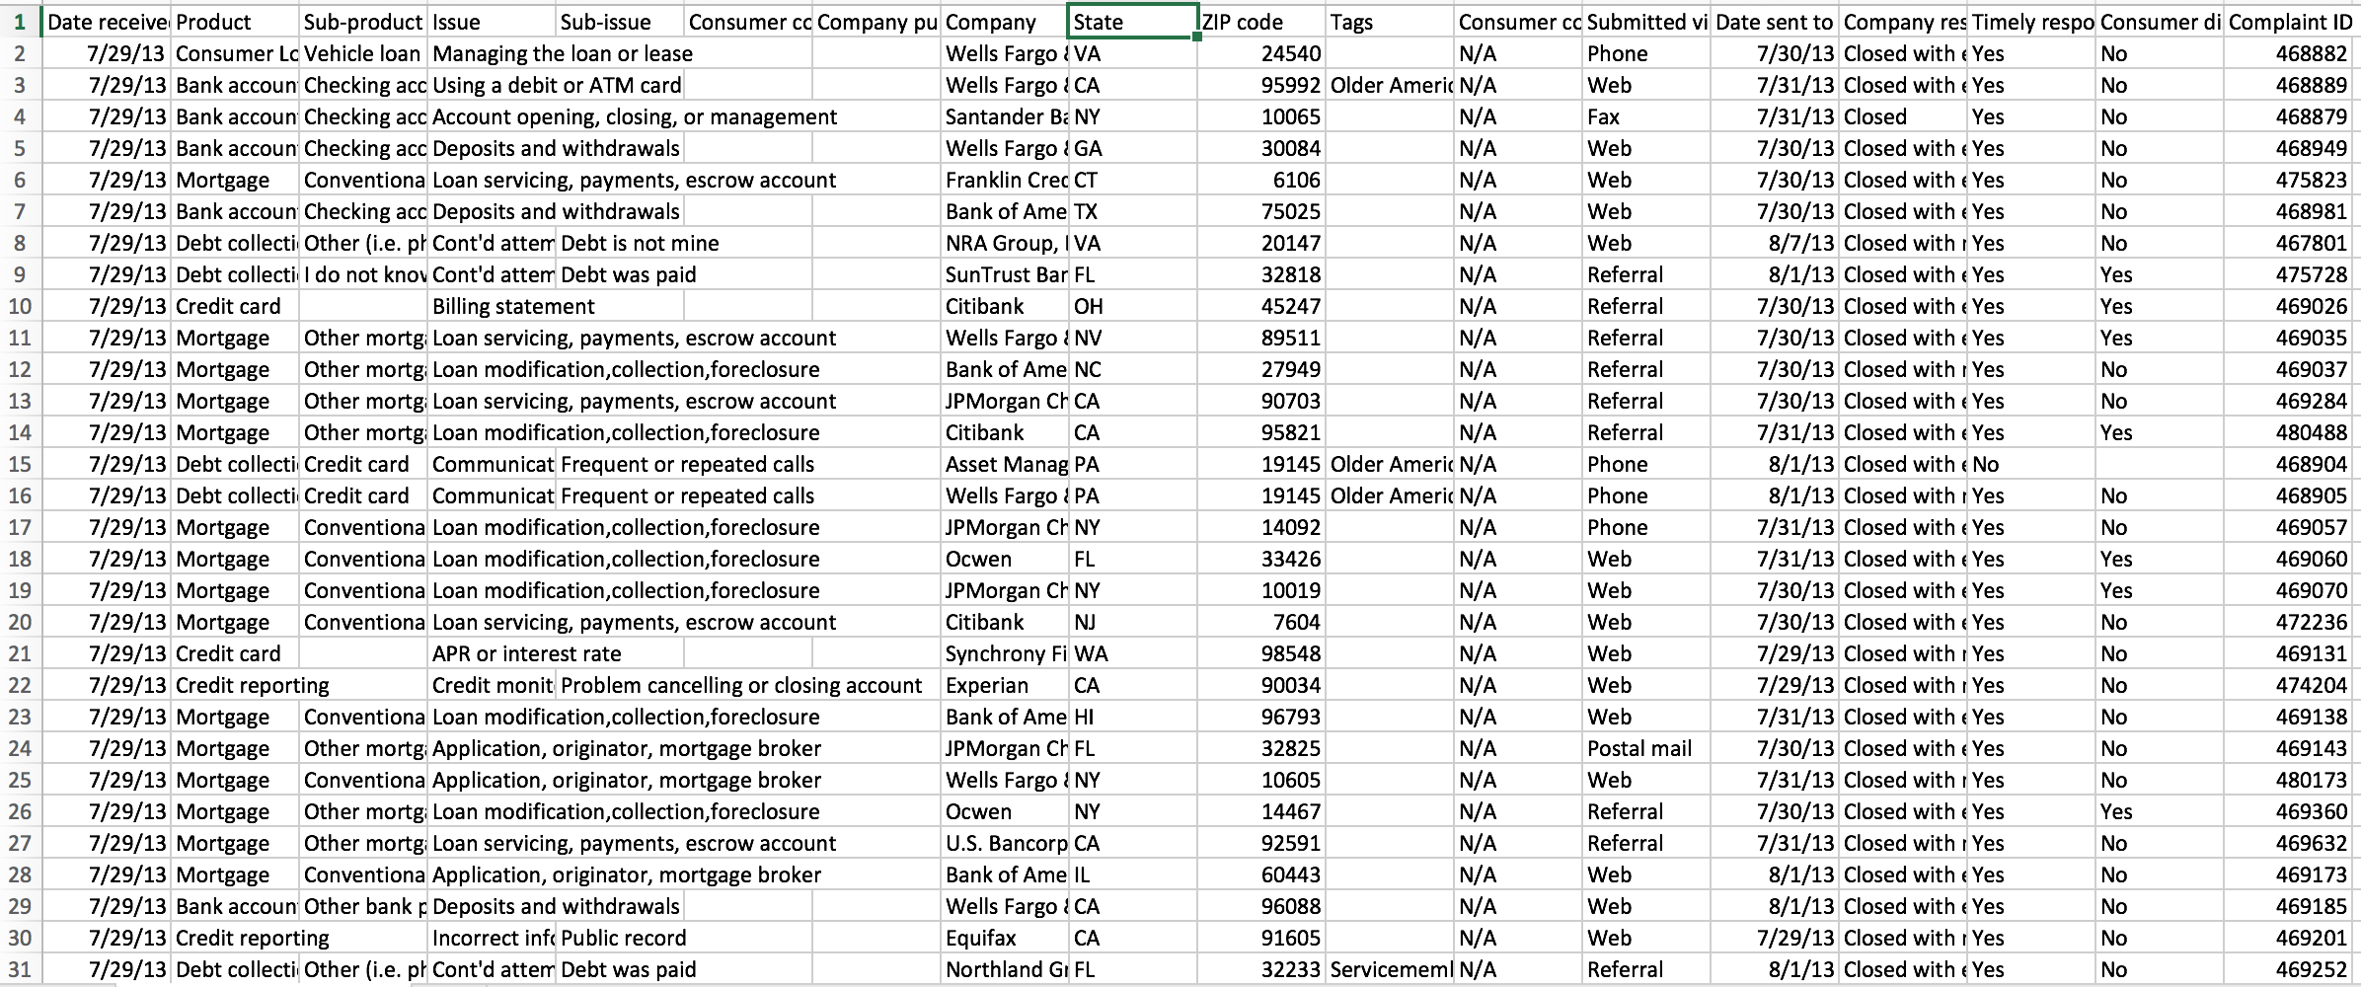
Notes:
Here is a screenshot of our data set, it ranges from 2013 - 2016 , it contains information about each complaint and their corresponding values such as the product and sub product type, consumer narratives, company affected, address, and other various information

Slide 7
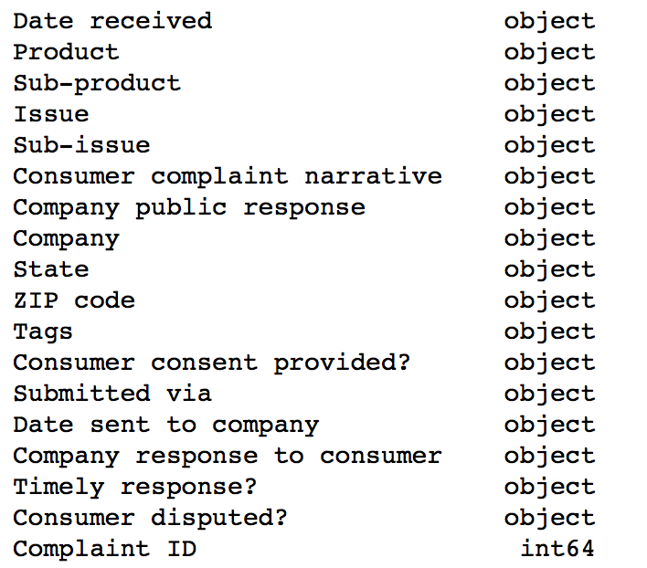
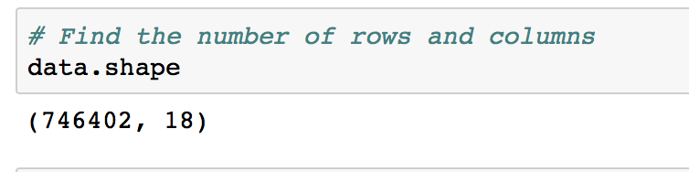
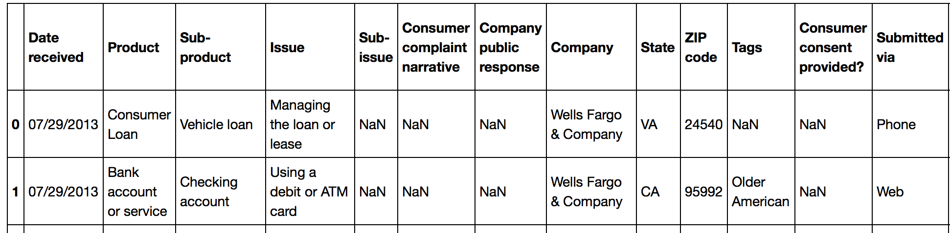
Data
Notes:
In our data there was approximately seven hundred thousand rows and 18 columns. These are the 18 columns and their corresponding data type. All of the data types are objects expect for complaint ID which is int64. Here is a snippet of our data set containing only the first two rows and 14 columns.

Slide 8
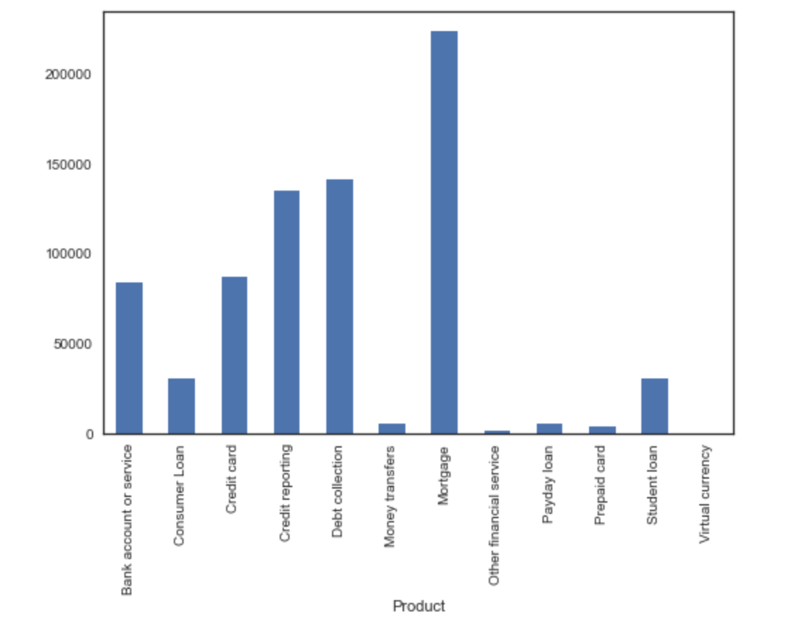
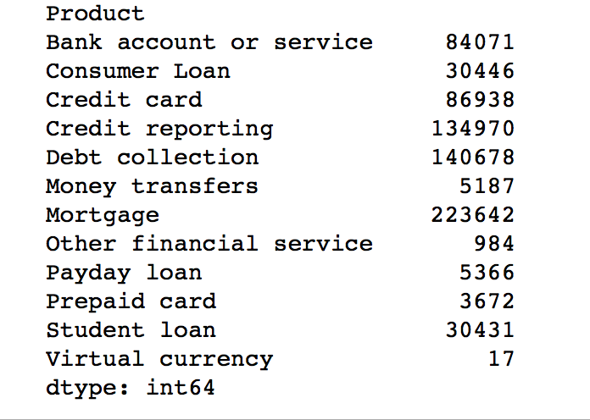
How many complaints raised against each product?
Notes:
We analyzed our data to calculate the number of complaints raised against each product. According to the results, mortgage was the number one and second was debt collection, the least amount of complaints raised was for virtual currency. Here is a visual representation of analyzed results. and this a snippet of our code to output the result.

Slide 9
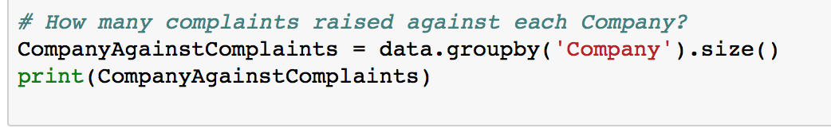
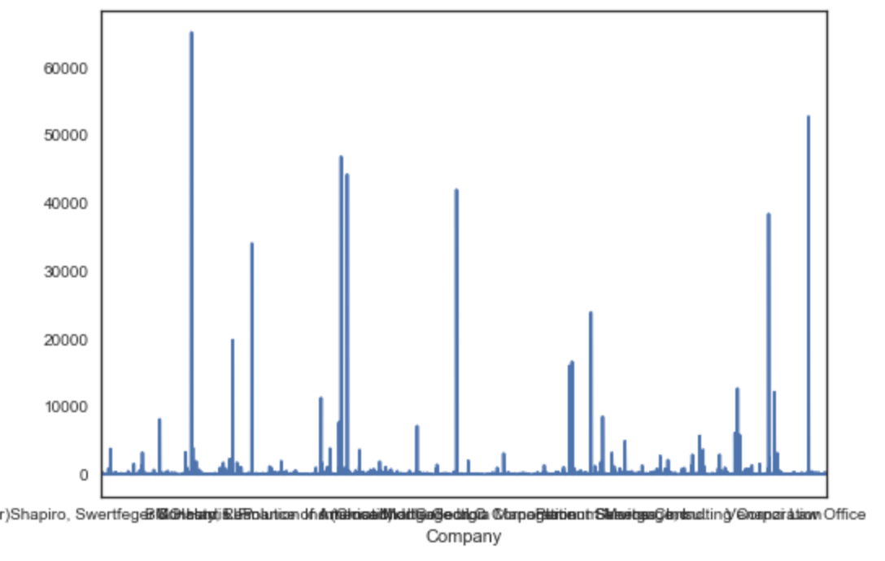
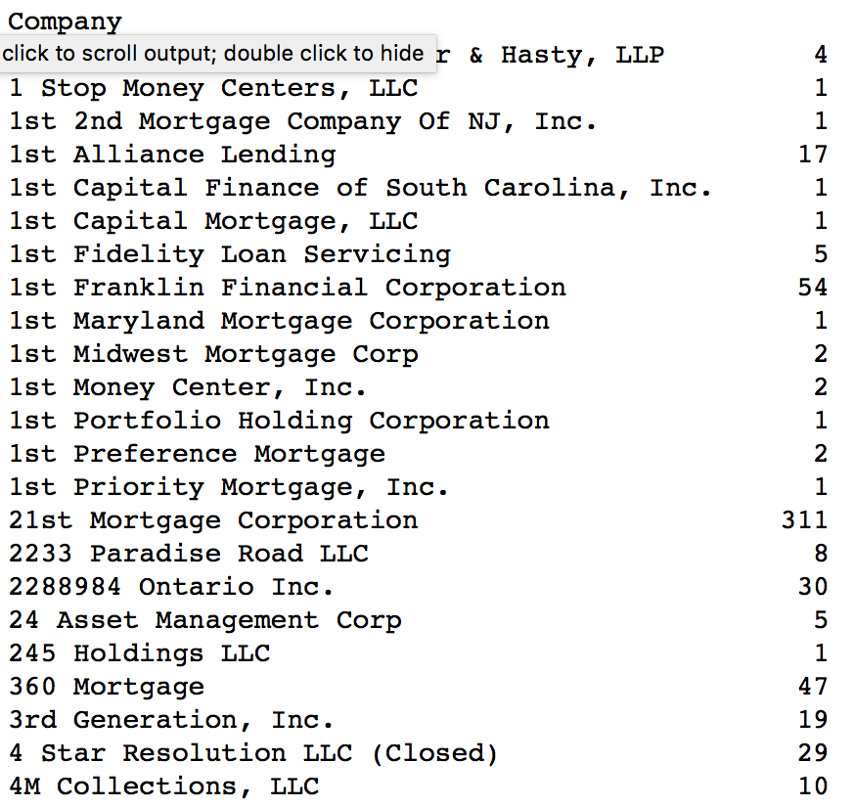
How many complaints raised against each company?
Notes:
To find the number of complaints raised against each company instead of products we used this snippet of code to reproduce these results. The graph displays that again mortgage companies raised the most amount of complaints . There were 311 consumer complaints raised against 21st Priority Corporation.

Slide 10
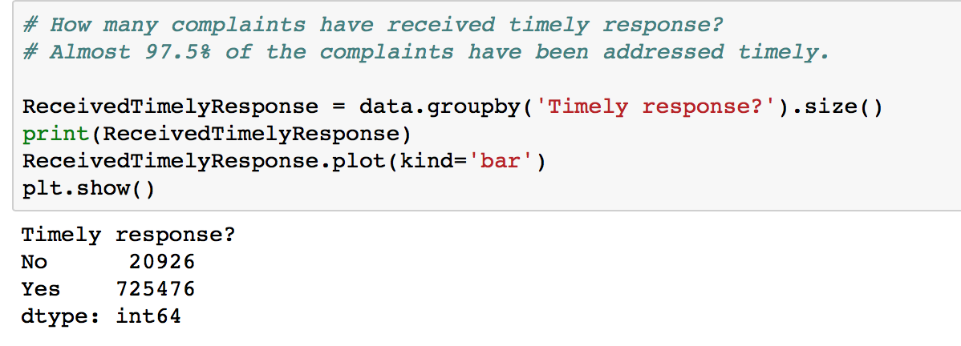
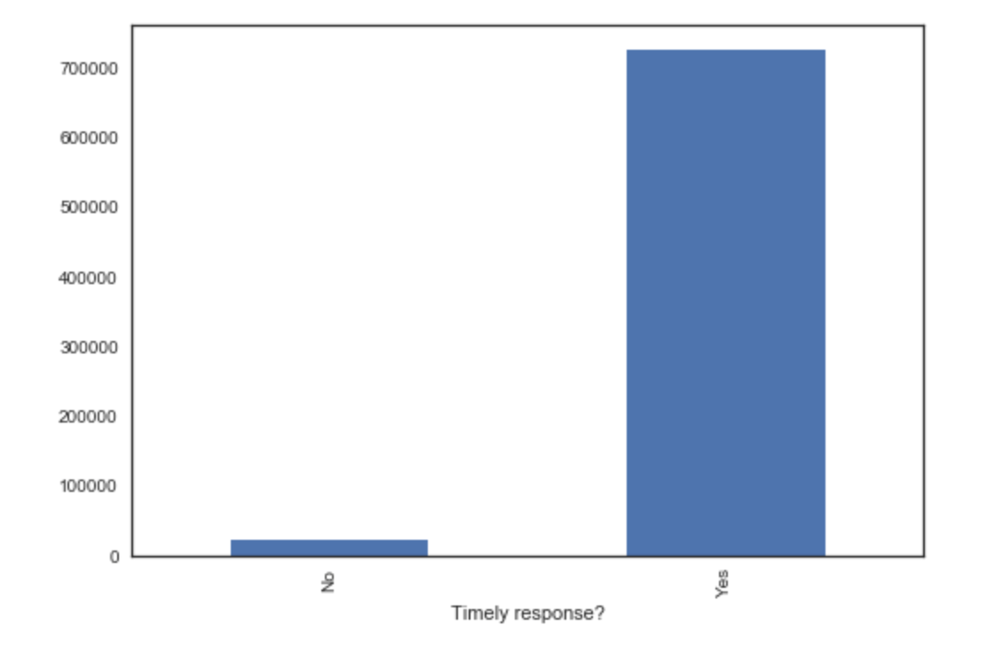
How many complaints have received timely response?

Slide 11
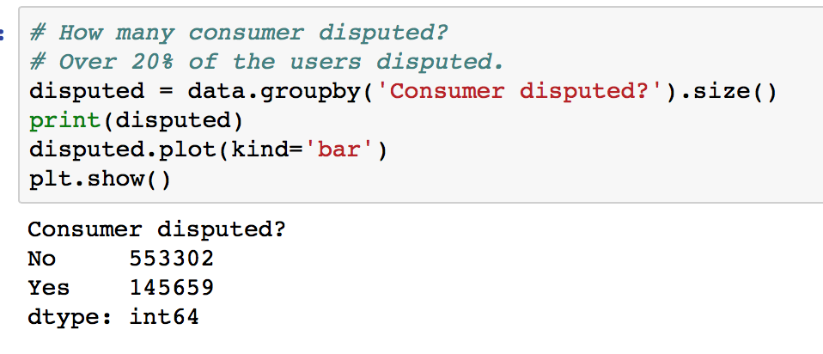
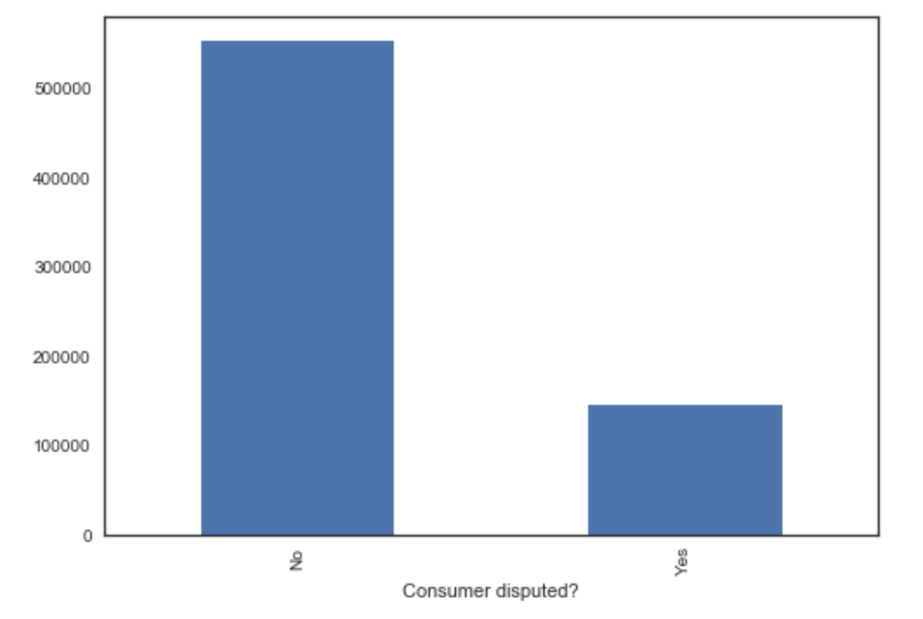
How many consumer disputed?

Slide 12
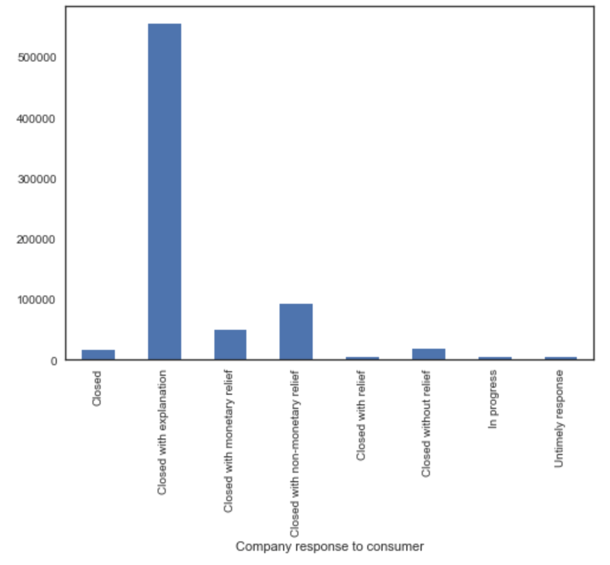
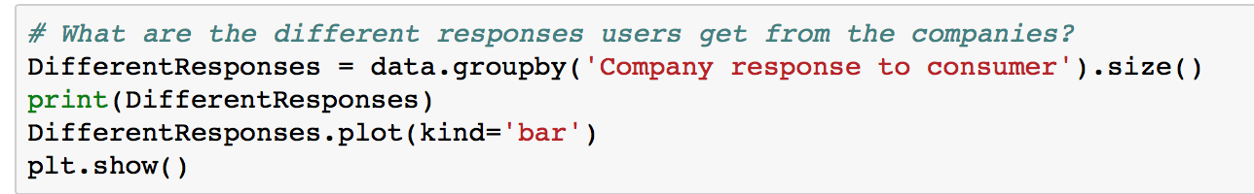
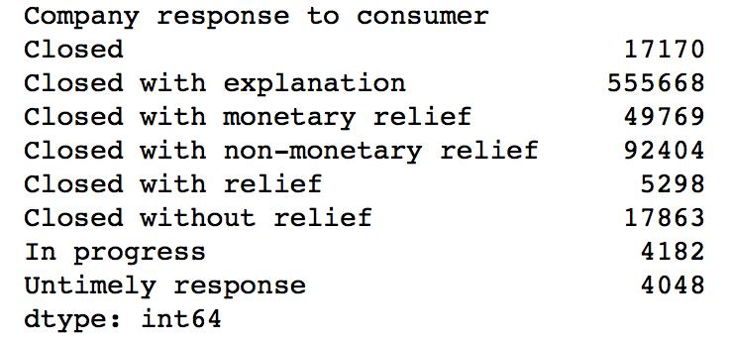
Different types of responses from companies

Slide 13
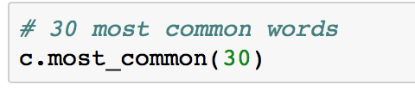
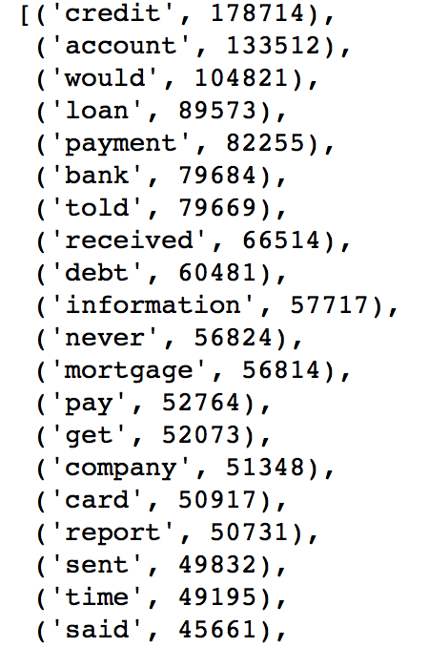
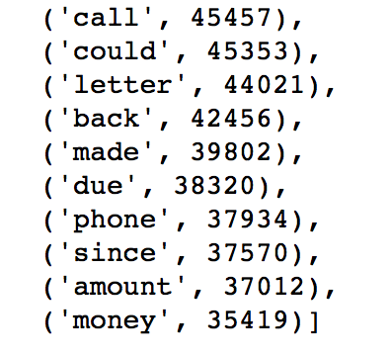
Most common words

Slide 14
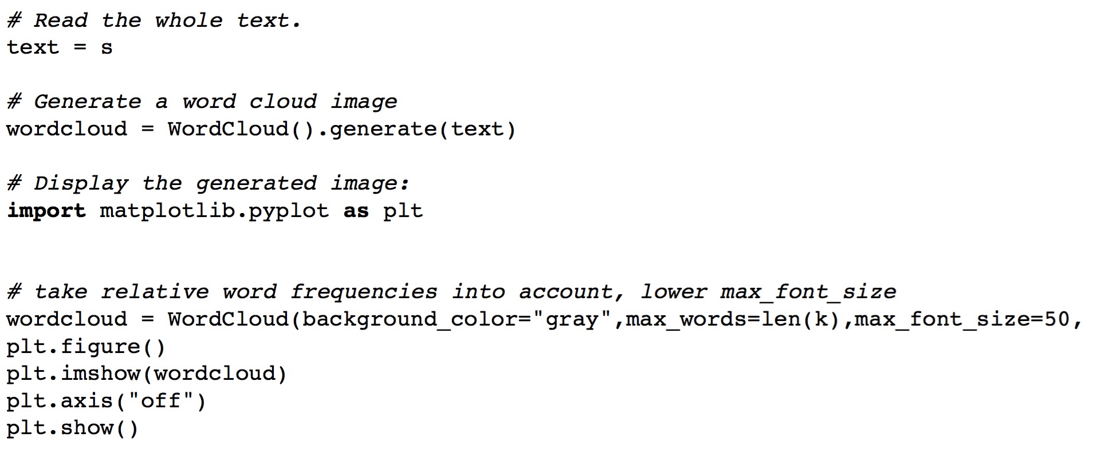
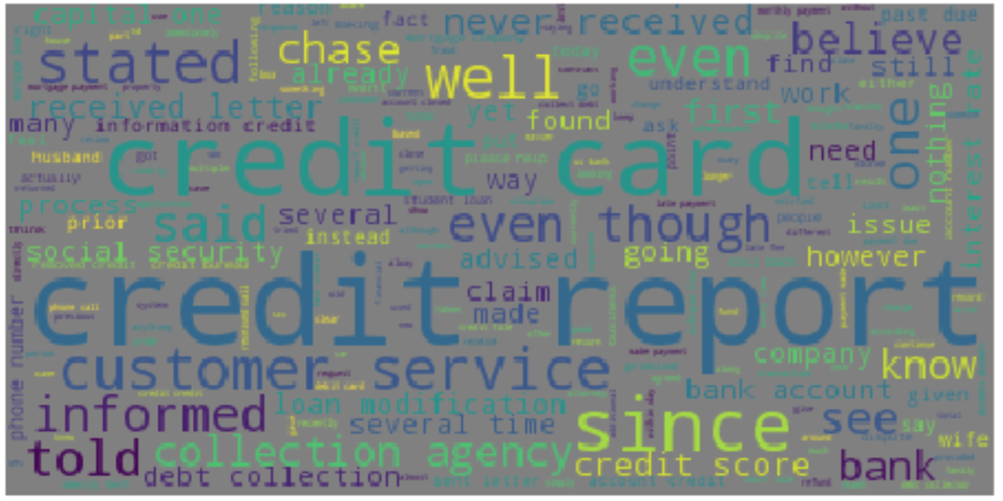
Word frequencies

Slide 15
Questions?

